Slide 1
Online GPS II/MAPP
Meetings 1 – 10

Slide 2
Meeting 6 Helping Children with Birth Family Connections

Slide 3
License Rights to OCFS
Center for Development of Human Services, Institute for Community Health Promotion, SUNY Buffalo State acknowledges the State of New York’s and the Office of Children and Family Services’ royalty-free, non-exclusive and revocable license to reproduce, publish, distribute, or otherwise use any and all material herein for the limited purpose of training GPSII/MAPP Leaders and for as long as such materials and such training are deemed appropriate by NYS OCFS.
The Children’s Alliance of Kansas (CAOK) is the current national owner of the copyrighted “toolbox” of MAPP programs. NYS Office of Children and Family Services (NYS OCFS)/Center for Development of Human Services (CDHS) has permission from CAOK to provide MAPP programs (GPSII/MAPP, Caring For Our Own, Deciding Together, Shared Parenting, Mini-MAPP, and Child Sexual Abuse) to certify leaders through leader certification workshops and directly to foster/adoptive parents in New York State.
In order to better meet the needs of children and families in New York State, PS-MAPP was revised in 2004 and renamed GPSII/MAPP. Further revisions were made in 2005 after considering the feedback from MAPP Leaders throughout the state, and minor revisions and reformatting occurred in 2009. Significant revisions to the content and updating to reflect best practice and legal changes in New York State were made and approved by NYS OCFS in 2012 for this edition.
© 2009 Children’s Alliance of Kansas. Revised with permission NYS OCFS.

Slide 4
Rules of the Road
Placeholder

Slide 5
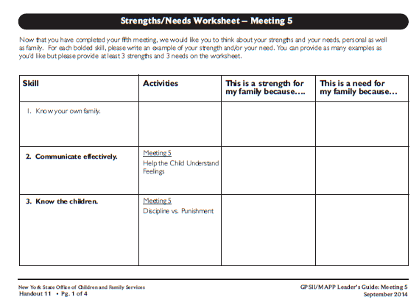
Roadwork from Last Meeting:
Meeting 5 Handout 11, Strength/Needs Worksheet

Slide 6
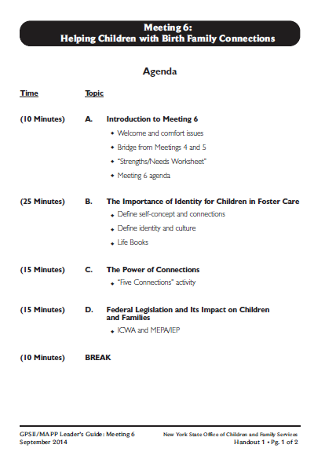
Let’s look at:
Handout 1

Slide 7
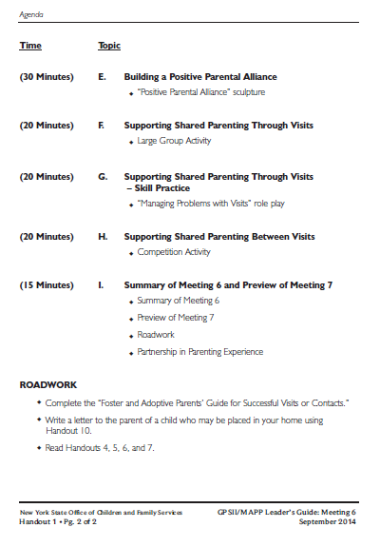

Slide 8
Lifebooks

Slide 9
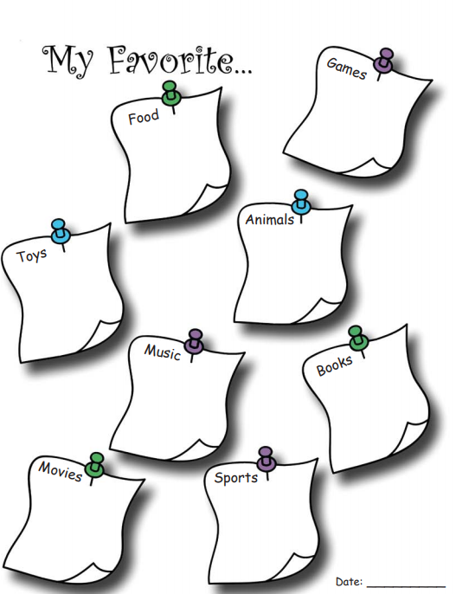
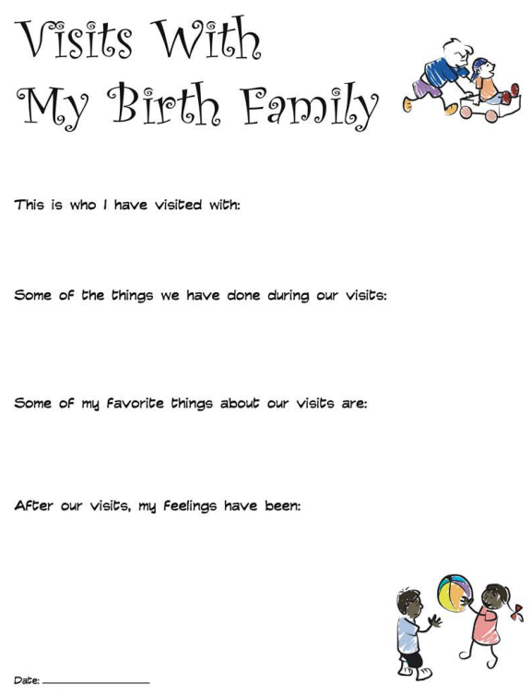

Slide 10
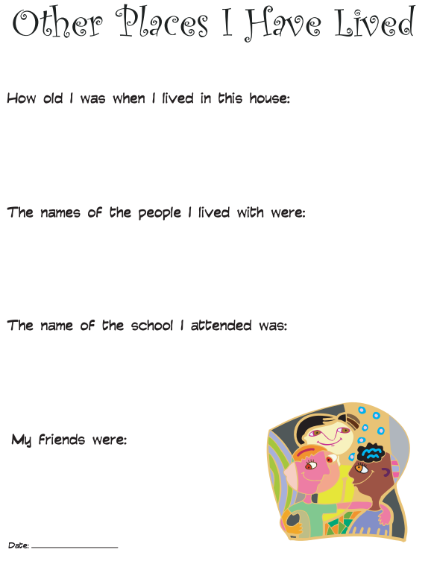
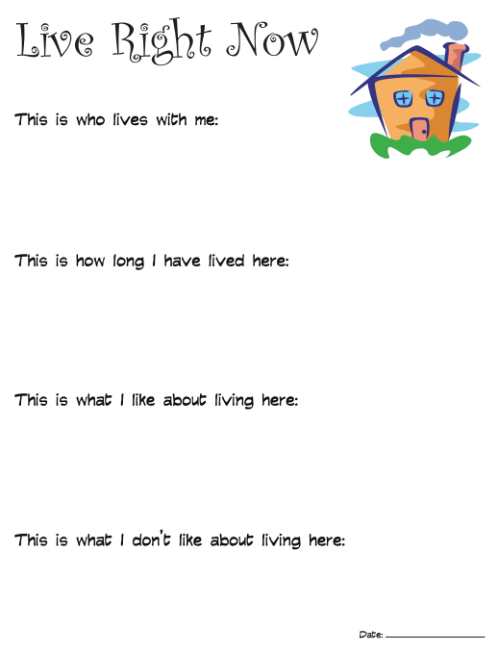

Slide 11
Let’s look at: Handout 2

Slide 12
What are some things that make one culture different from another culture?

Slide 13
What are some of the values, customs and traditions that your family has maintained from your cultural roots?

Slide 14
How have you and your family been able to maintain your cultural identity?

Slide 15
The Triangle Family

Slide 16
The Triangle Family

Slide 17
The Triangle Family

Slide 18
Connections in Your Life

Slide 19
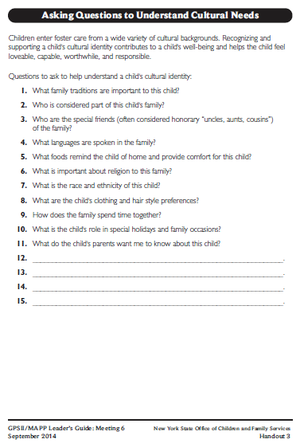
Let’s look at:
Handout 3

Slide 20
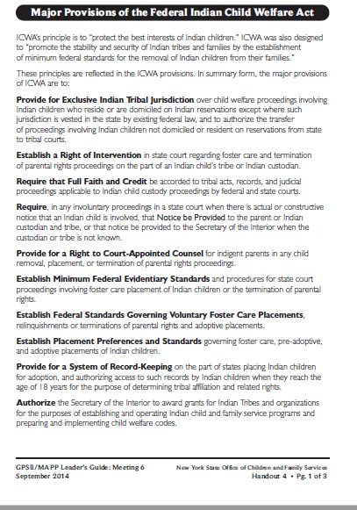
Let’s look at:
Handout 4

Slide 21
Indian Child Welfare Act (ICWA)
The Indian Child Welfare Act:
Provides funds to tribes to operate child and family services programs;
Gives tribes exclusive jurisdiction over any American Indian child who resides within the reservation;
Gives tribal courts exclusive jurisdiction over any child who is a ward of the tribal court

Slide 22
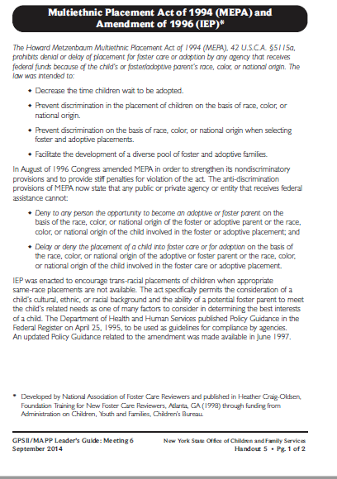
Let’s look at:
Handout 5

Slide 23
Multiethnic Placement Act of 1994 (MEPA) and Amendment of 1996 (IEP)
Decreases the time children wait to be adopted;
Prohibits denial or placement delays (by any agency receiving federal funds) because of race, color, or national origin;
Encourages transracial placements when appropriate same-race placements are not available;

Slide 24
Multiethnic Placement Act of 1994 (MEPA) and Amendment of 1996 (IEP)
Prevents discrimination in child placement or in the choice of foster and adoptive homes, based on race, color, or national origin;
Develops a diverse pool of foster and adoptive families

Slide 25
Positive Parental Alliance Demonstration: Roles
2 Parents
Child
Caseworker
2 Foster Parents

Slide 26
Positive Parental Alliance Demonstration:
Child joins family
Parent
Child
Parent

Slide 27
Cycle of Need
Need
Expression
(Behavior)
Intervention
Relaxation

Slide 28
Positive Parental Alliance:
Child becomes aware of parental alliance
Parent
Child
Parent

Slide 29
Positive Parental Alliance Demonstration:
Child in the middle
Parent
Child
Parent

Slide 30
A Positive Parental Alliance is formed when all of the important adults in a child’s life are working together to meet the child’s needs

Slide 31
Positive Parental Alliance Demonstration :
Child back in original position
Parent
Child
Parent

Slide 32
Positive Parental Alliance Demonstration:
Parents in conflict
Parent
Child
Parent

Slide 33
Positive Parental Alliance Demonstration :
Child sides with one parent…
Parent
Child
Parent

Slide 34
Positive Parental Alliance Demonstration :
Child sides with the other parent…
Parent
Child
Parent

Slide 35
Positive Parental Alliance Demonstration :
Caseworker
Parent
Child
Worker
Parent

Slide 36
Positive Parental Alliance Demonstration:
Foster Parents
Parent
Foster
Parent
Child
Worker
Parent
Foster
Parent

Slide 37
Positive Parental Alliance Demonstration:
All of the important adults working together
to meet the child’s needs
Parent
Foster
Parent
Worker
Child
Parent
Foster
Parent

Slide 38
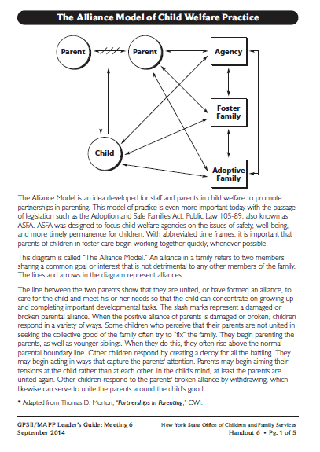
Let’s look at:
Handout 6

Slide 39
Shared Parenting
Occurs when two or more adults have joint responsibility for care, nurturing, and decision making for the same child.
It is an important part of building a positive parental alliance.

Slide 40
What are the Benefits
…for parents when caring, nurturing and decision making is shared with foster parents?
…for foster parents when care, nurturing, and decision making is shared with parents?
…for caseworkers when care, nurturing and decision making is shared amongst everyone involved in the child’s life?

Slide 41
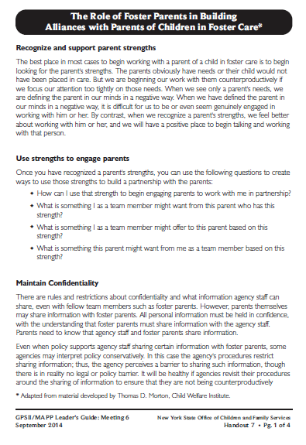
Let’s look at:
Handout 7

Slide 42
The Role of Foster Parents in Building Alliances with Parents of Children in Foster Care
Recognize and support parent strengths
Use strengths to engage parents
Maintain confidentiality
Manage personal emotions
Share power and control
Model parenting skills, mentor and/or teach parents

Slide 43
Potential Problems with Visits

Slide 44
Benefits of Visits:
For Children | For Parents | For Siblings and Relatives | For Foster Parents
 |  |  | For Caseworker

Slide 45
How Might Foster Parents Manage:
Parent may not show up for a scheduled visit
Child may not want to leave parents
Children’s behavior after a visit

Slide 46
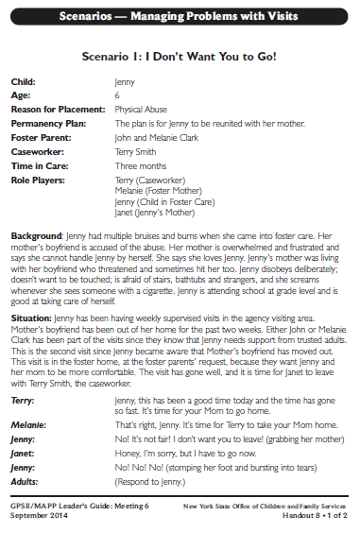
Let’s look at:
Handout 8

Slide 47
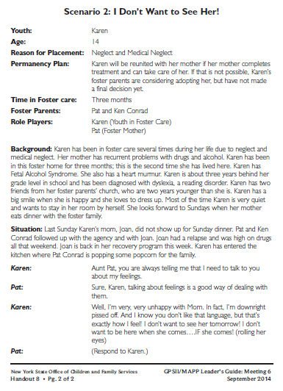
Let’s look at:
Handout 8
(Page 2 of 2)

Slide 48
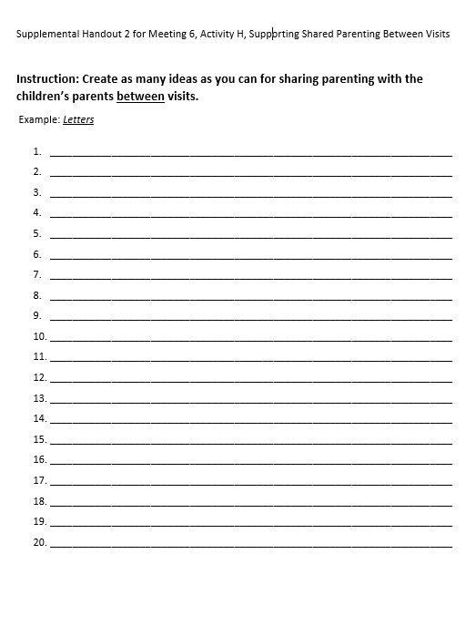
Let’s look at:
Supplemental Handout 2

Slide 49
Twelve Skills for Successful Fostering and Adopting
Know your family
Communicate Effectively
Know the children
Build strengths, meet needs
Work in partnership
Be loss and attachment experts
Manage behaviors
Build connections
Build self-esteem
10. Assure health and safety
Assess impact
Make an informed decision

Slide 50
Roadwork
Complete the “Foster and Adoptive Parents’ Guide for Successful Visits or Contacts
Write a letter to the parent of a child who may be placed in your home using Handout 10
Read Handouts 4, 5, 6, and 7

Slide 51
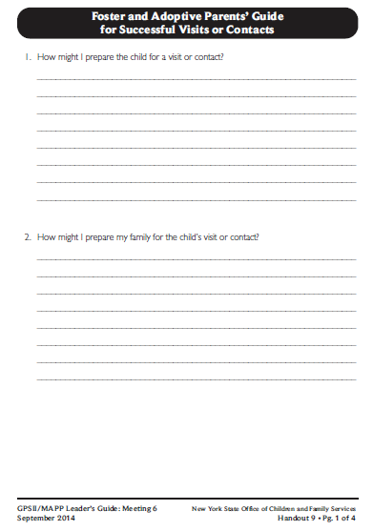
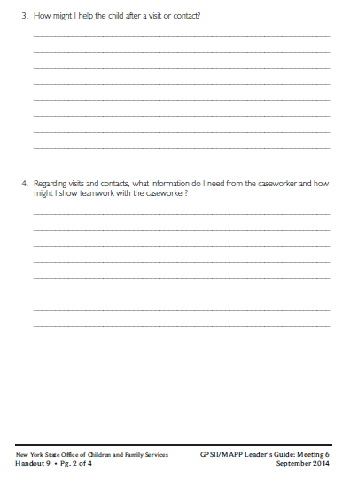
Let’s look at: Handout 9

Slide 52
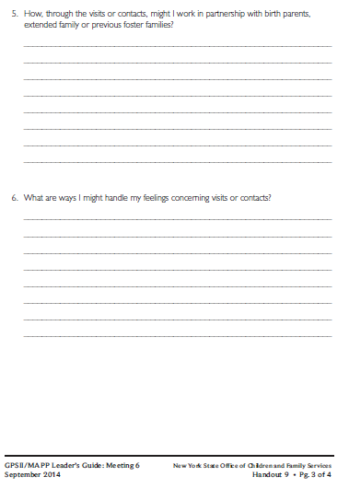
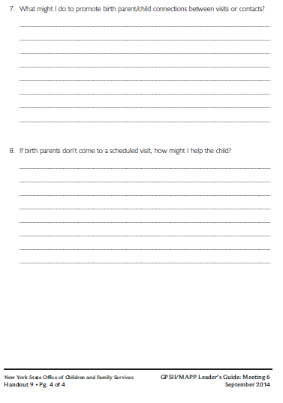

Slide 53
It’s Time for a PIP!
Partnership
In
Parenting Experience

